Slide 1
AI Fitness Trainer Using Pose Estimation
21BAI1110 - RITIK RAJ
21BAI1704 – RITIK NEHRA

Slide 2
Existing Problem Statement:
Achieving high accuracy and reliability in real-time pose estimation across various exercises.
Accurately recognizing and categorizing different exercises based on pose estimation.
Developing effective algorithms to provide real-time feedback on exercise form, posture, and technique.
Creating personalized workout routines and recommendations based on individual fitness levels.
Extending pose estimation models to accurately handle scenarios involving multiple people exercising together, such as group fitness classes or partner workouts.

Slide 3
Uniqueness :
AI Fitness Trainer using Pose Estimation lies in its ability to offer personalized, real-time feedback on exercise form and technique. This level of customization and immediacy sets it apart from traditional fitness tracking methods and even many digital fitness platforms. By leveraging pose estimation technology, this AI trainer can analyze users' movements as they perform exercises, providing instant guidance to help them optimize their form, prevent injuries, and maximize workout effectiveness. This real-time feedback loop creates a highly engaging and interactive fitness experience tailored to each individual's needs and goals, making it a powerful tool for improving exercise performance and overall fitness outcomes.

Slide 4
Abstract :
In recent years, advancements in AI and Deep learning technologies have paved the way for innovative solutions in the fitness industry. We present a groundbreaking approach to fitness coaching leveraging AI-powered pose estimation techniques. Unlike conventional methods, our system offers real-time, personalized feedback on exercise form and technique, enhancing the effectiveness and safety of workouts. By analyzing individual body movements, the AI fitness trainer tailors workout recommendations to each user's fitness level, goals, and limitations. Automatic repetition tracking eliminates the need for manual input, while integrated feedback mechanisms foster engagement and motivation. This accessible and convenient solution transcends traditional barriers to fitness coaching, empowering users to achieve their goals anytime, anywhere. Continual learning and adaptation ensure the system evolves alongside users, while seamless integration with emerging technologies further enhances the user experience. With comprehensive health monitoring capabilities, our AI-powered fitness trainer provides users with a holistic approach to achieving optimal health and wellness.

Slide 5
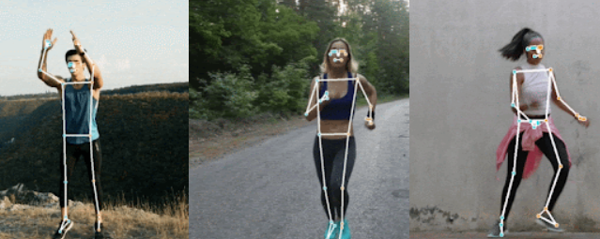
Introduction :
In the realm of fitness coaching, the integration of artificial intelligence (AI) and computer vision technologies has ushered in a new era of personalized and effective training methodologies. This paper explores the transformative potential of an AI-powered fitness trainer utilizing pose estimation techniques. Unlike traditional coaching methods, this innovative system offers real-time, individualized feedback on exercise form and technique, optimizing workout performance and minimizing the risk of injury. By leveraging pose estimation algorithms, the trainer analyzes users' movements to tailor workout recommendations to their unique fitness goals and abilities. Automatic repetition tracking and integrated feedback mechanisms further enhance the user experience, fostering engagement and motivation. With its accessibility and adaptability, this solution represents a paradigm shift in fitness coaching, empowering individuals to achieve their fitness aspirations with precision and efficiency.

Slide 6
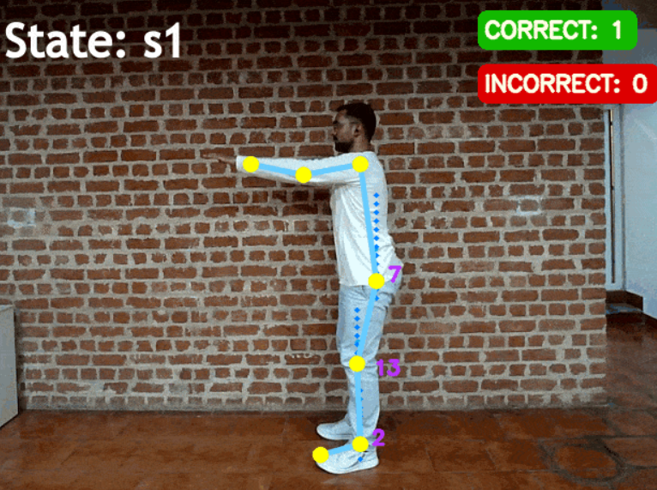
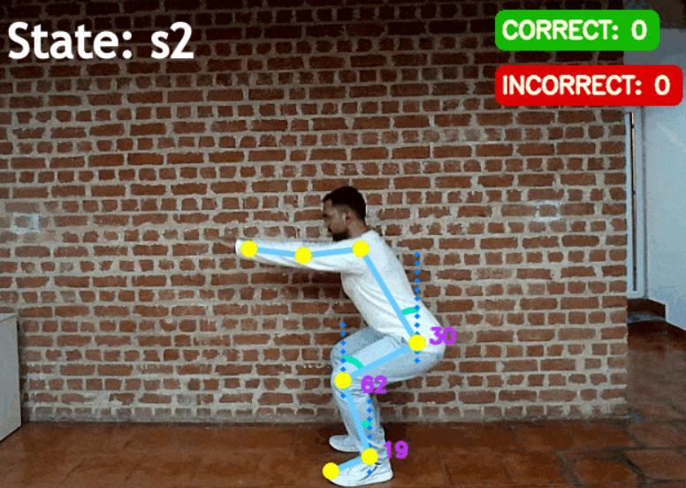
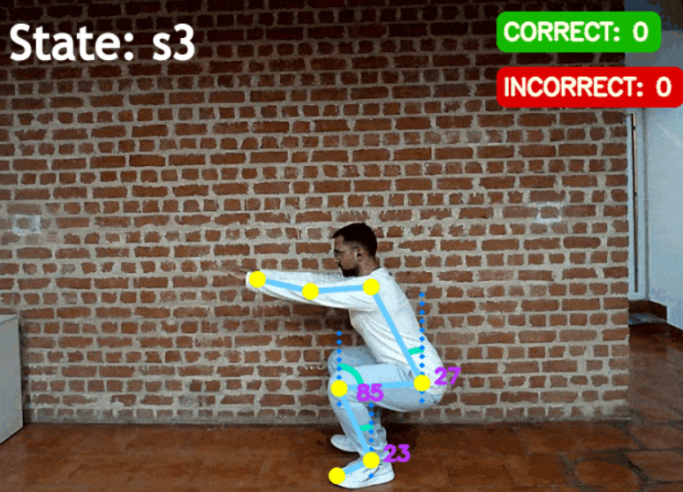
Steps & Process :

Slide 7
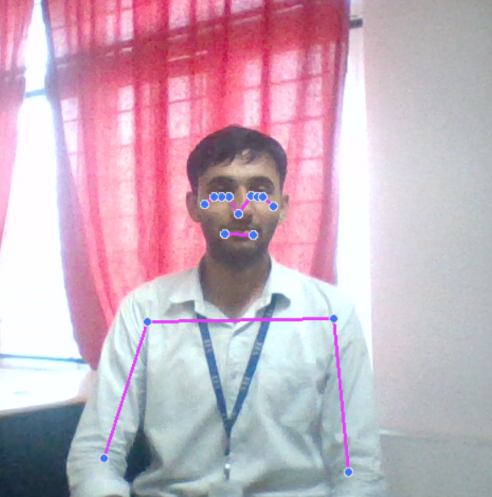
Building our AI Fitness Trainer: A Step-by-Step Approach
Our AI Trainer leverages pose estimation to deliver real-time feedback on exercise form. The methodology involves several key steps.
The system relies on real-time video input from a webcam.
Video frames are captured from the webcam.
Each frame is converted from BGR (OpenCV format) to RGB (MediaPipe format) for compatibility with MediaPipe Pose.
MediaPipe Pose, a pre-trained machine learning model, is used to process each frame and detect body keypoints (landmarks) corresponding to various body joints.

Slide 8
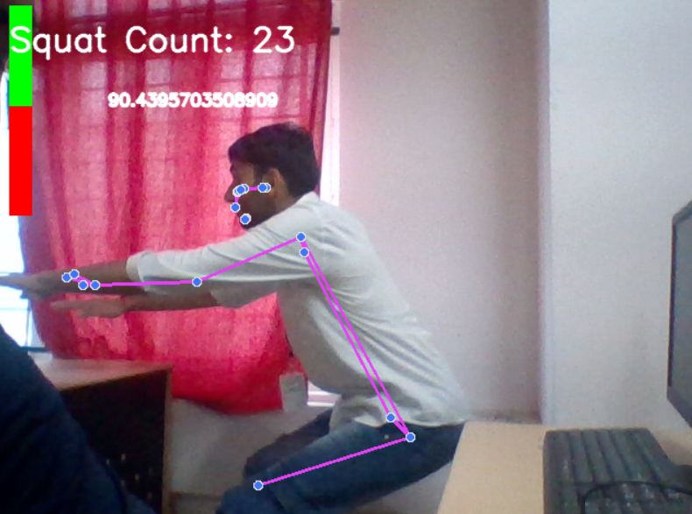
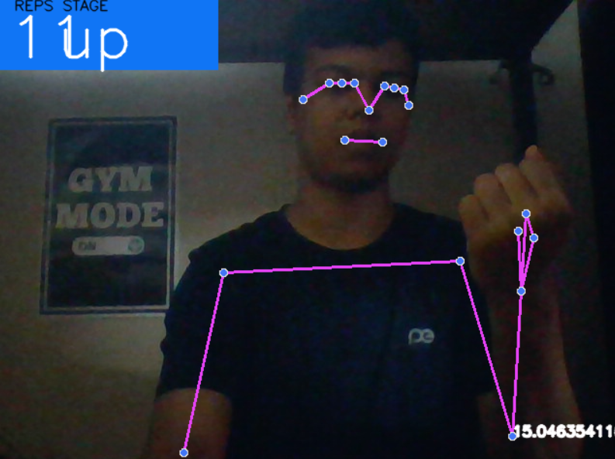

Exercise-Specific Analysis
Squats: Angles between shoulder, hip, and knee are calculated to determine squat depth. A counter is incremented when a full squat is detected based on predefined angle thresholds.
Planks: The angle between hips, knees, and ankles is calculated. A timer is triggered when the angle indicates a plank position and reset when the pose deviates. The timer duration can be used to estimate plank repetitions if a standard hold time is defined.
Push-up: Angles of both elbows relative to the shoulders and wrists are calculated . The counter is incremented when the arms transition from straight to bent and vice versa.
Bicep Curl Analysis: The code focuses on Shoulder, Elbow and Wrist. The angle between the upper arm (shoulder-elbow) and forearm (elbow-wrist) is calculated. A flag variable (curl_state) is used to track the curl state (up or down).

Slide 9
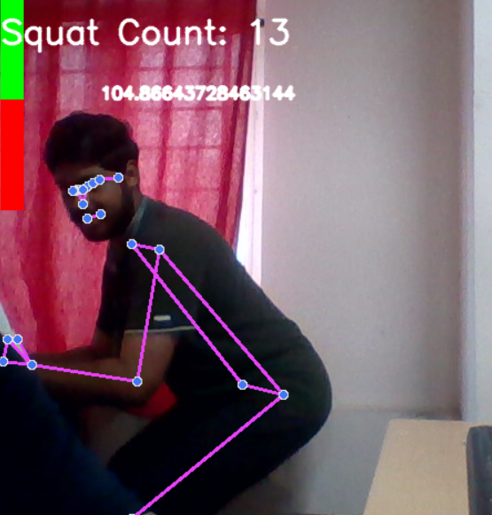
Assessing the Effectiveness of our AI Fitness Trainer
We assess the effectiveness of our AI Fitness Trainer through several approaches that demonstrate its positive impact on users and its training capabilities.
Faster learning curves: Real-time feedback and visualization tools provided by the AI can accelerate skill development and improve exercise technique more quickly. This allows users to progress through training programs at a faster pace.
The the AI Fitness Trainer demonstrates promise in enhancing trainer effectiveness by expanding reach, improving training specificity, and optimizing time management. Additionally, it has the potential to reduce training costs and accelerate user learning curves.

Slide 10

References :
Future work:
We are actively working on collaborating with fitness professionals to define objective form assessment criteria.
To develop the AI to adapt its coaching style based on user personality and preferences, providing motivational support tailored to individual needs.
IEEE Xplore: https://ieeexplore.ieee.org/
PubMed: https://pubmed.ncbi.nlm.nih.gov/
ArXiv: https://arxiv.org/
ScienceDirect: https://www.sciencedirect.com/
Intelligent Fitness Trainer System Based on Human Pose Estimation: https://www.alfa-ai.com/
Xiao, B., Wu, H., Wei, Y., & Liang, X. (2018). Simple baselines for human pose estimation and tracking.

Slide 11
Thank you

